Slide 1
SELF FEEDING PLANT
Project by:
Nidhi Dubey
Ruchika Dubey

Slide 2
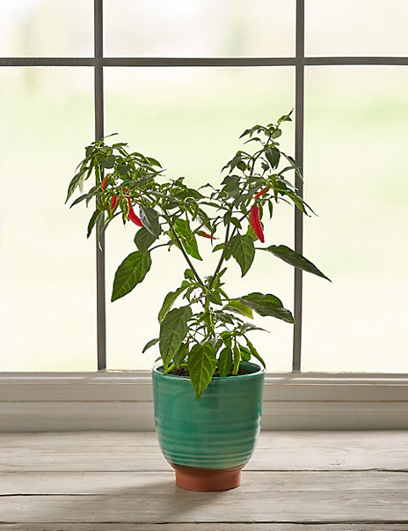
What Does A Plant Require To Grow?
Sunlight
Air(for CO2)
Water
nutrients
Plants Provide Us With:
food, fiber, shelter, medicine, and fuel and The basic food for all organisms. In the process of food production, oxygen is released which is essential to life.

Slide 3
But Due To Busy Day To Day Life:
We dont provide them with enough water and sunlight . this can cause them to die, hence increasing global warming.
To over come this, we can introduce self feeding plant. as it provides enough water and makes sure the plants get sufficient sunlight to grow.

Slide 4
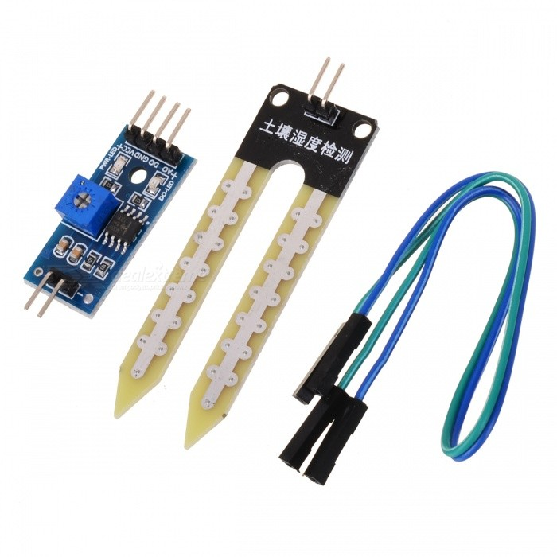
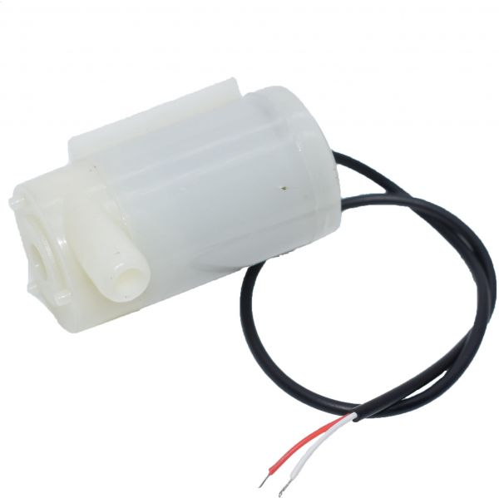
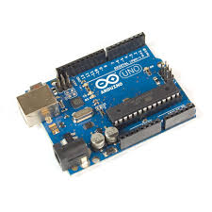
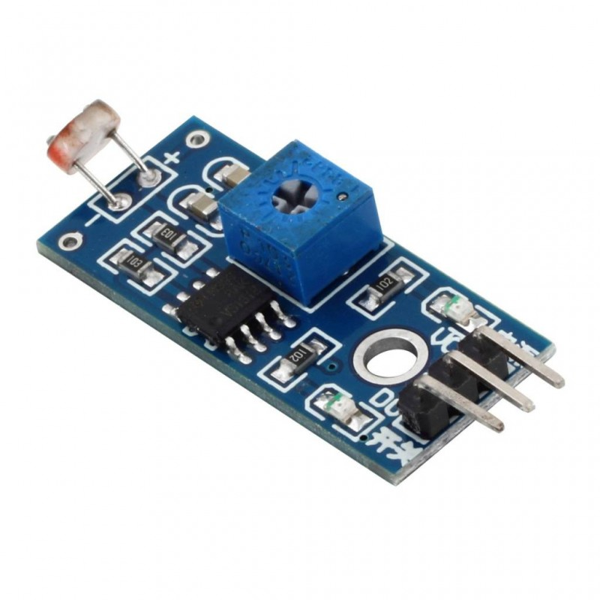
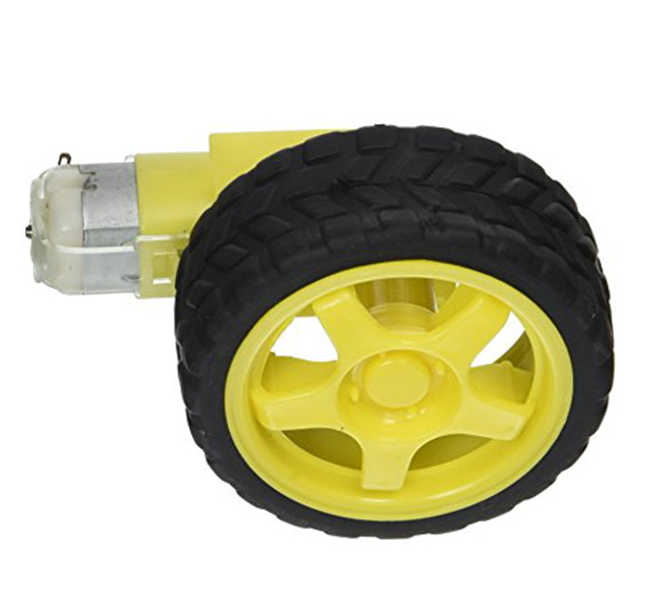
Working Of The Project:
Soil Moisture Sensor
Water Pump
Arduino Uno
L.D.R Sensor
Servo Motor

Slide 5
Advantages Of The Project :
We dont need worry about the plants as they are self sufficient and can grow with enough water and sunlight.
Will help the plants to grow hence, reducing carbon dioxide levels and certain pollutants, such as benzene and nitrogen dioxide.
Reducing Global Warming and Keeping air temperatures down.

Slide 6
Future Scope:
The signs of global warming are everywhere, and are more complex than just climbing temperatures, hence if we grow plants and trees as much as we can, we can help stop global warming in future.
In future more people will move from a rural to an urban area mostly because of economic and employment reasons so more area will develop from rural to urban causing decrease in plants so we can adapt this project as it is made for people in urban area.

Slide 7
THANK YOU!

